Slide 1
Chapter 1: Introduction

Slide 2
Outline
What Operating Systems Do?
Computer-System Organization
Computer-System Architecture
Operating-System Operations

Slide 3
Outline
What Operating Systems Do?
Computer-System Organization
Computer-System Architecture
Operating-System Operations

Slide 4
什麼是作業系統？

Slide 5
Computer System Structure
Computer system can be divided into four components:
Hardware
Operating system
Application programs –
Users

Slide 6

Four Components of a Computer System

Slide 7
Q: 作業系統有什麼功能?
Hint: 如果沒有作業系統會發生什麼事?
For example: A Hello World Program

Slide 8
注意: 使用者是和應用程式互動 (或是透過應用程式和OS互動, 例如: 存取硬碟上的檔案)
因此, 我們探討OS會關心應用程式如何和OS互動(不是使用者和OS的互動)

Slide 9
What Operating Systems Do?
A software that acts between user applications and the computer hardware.
Goal
Manages the computer hardware and provides an environment for application programs to run
Program 1
Program 2
OS
Device 1
Device 2
Device 3

Slide 10
Defining Operating System
A common definition
The OS is the one program running at all times
Usually called the kernel

Slide 11
Outline
What Operating Systems Do?
Computer-System Organization
Computer-System Architecture
Operating-System Operations

Slide 12
學習作業系統為什麼要學習計算機組織與電腦架構？

Slide 13
Outline
What Operating Systems Do?
Computer-System Organization
Interrupts
Storage structure
Computer-System Architecture
Operating-System Operations

Slide 14
A Computer System
A computer system consists of CPU and multiple device controllers (see the following slide)
Device controller: hardware
Also called special-purpose processors
Contains local buffer and special-purpose registers
Device drivers: software
Part of an OS (see the following slide)
A device driver for each device controller

Slide 15
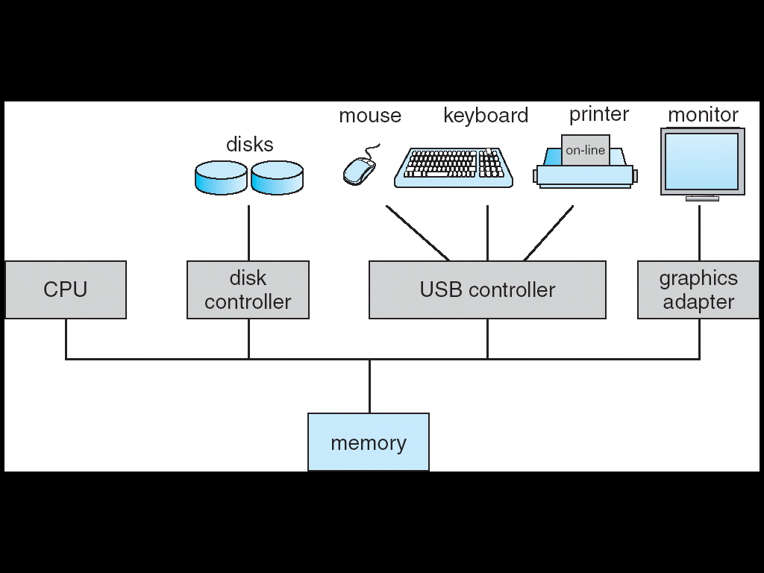
A Computer System
CPU registers
device registers
Local buffer

Slide 16
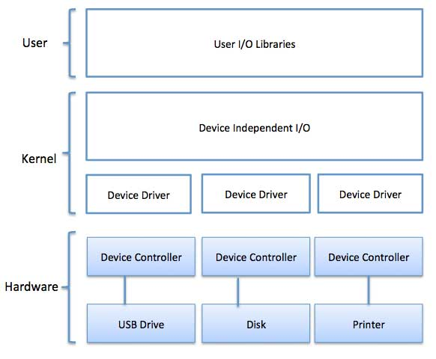
A Device Driver for Each Device Controller
User Applications
https://www.tutorialspoint.com/operating_system/os_io_software.htm

Slide 17
電腦內部有CPU和許多周邊控制器(Device Controllers), 以讀取硬碟的資料為例子!
問題 1: CPU如何通知硬碟控制器讀取硬碟資料？
問題 2:當讀取完畢, 硬碟控制器如何通知CPU？

Slide 18
問題 1: CPU如何通知周邊裝置？ 問題 2:周邊裝置如何通知CPU？
Answer 1: 藉由讀寫Device Controller的內部暫存器
Answer 2: Device controller informs CPU by issuing interrupts

Slide 19
Starting an I/O operation
Starting an I/O operation (e.g., read data from disks)
Device driver loads the appropriate registers within the device controller (see the following slide)
Device controller
Examines the contents of these registers
Determine what action to take
Start the actions
Transfer of data from the device to its local buffer
Once completed
Device controller informs the CPU via an interrupt

Slide 20
A Computer System
CPU registers
device registers
Local buffer

Slide 21
Question: 何謂中斷?中斷的用途?

Slide 22
Interrupts
Interrupt:
Device controllers signal CPUs an occurrence of a hardware event.
E.g., the completion of an I/O, a keypress,

Slide 23
Question : 中斷處理的整個過程?

Slide 24
Steps in Interrupts
In general
Device controller raises an interrupt
CPU catches the interrupt
CPU dispatches it to the interrupt handler
Interrupt handlers serve the interrupt

Slide 25
Steps in Interrupts (Cont.)
In general
Device controller raises an interrupt
CPU catches the interrupt
CPU dispatches it to the interrupt handler
Interrupt handlers serve the interrupt

Slide 26
Question: Device Controller如何觸發中斷?
Ans: By asserting a signal on the interrupt-request line

Slide 27
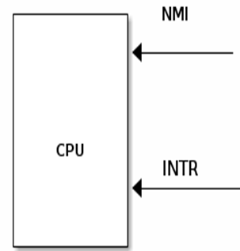


Interrupt Hardware Concepts
Device raise an interrupt
https://www.renesas.com/eu/en/support/engineer-school/mcu-programming-peripherals-04-interrupts

Slide 28
Steps in Interrupts (Cont.)
In general
Device controller raises an interrupt
CPU catches the interrupt
CPU dispatches it to the interrupt handler
Interrupt handlers serve the interrupt

Slide 29
Interrupt Hardware Concepts
Device raise an interrupt
CPU catch an interrupt
https://www.renesas.com/eu/en/support/engineer-school/mcu-programming-peripherals-04-interrupts

Slide 30
Question : CPU接收到中斷後怎麼辦呢?

Slide 31
Steps in Interrupts
In general
Device controller raises an interrupt
CPU catches the interrupt
CPU dispatches it to the interrupt handler
Interrupt handlers serve the interrupt

Slide 32
Interrupts Dispatches
Upon CPU catches an interrupt occurs, CPU is interrupted
CPU stops what it is doing
CPU transfers execution to a fixed address
Executes the interrupt service routine (ISR) for the interrupt

Slide 33
CPU Dispatch an Interrupt to ISR
…
mov eax, 0x60;
…
0x1000
CPU
…..
interrupt
OS
CPU dispatch an interrupt to ISR
Interrupt Service
Routine (ISR)

Slide 34
Steps in Interrupts
In general
Device controller raises an interrupt
CPU catches the interrupt
CPU dispatches it to the interrupt handler
Interrupt handlers serve the interrupts

Slide 35
Interrupt Handler (Interrupt Service Routine)
Interrupt handler (Interrupt service routine)
Perform a state save
Service the interrupt
Perform a state restore
Executes a retrun_from_interrupt instruction

Slide 36
問題: 為什麼要儲存state?然後復原state?

Slide 37
Without State Save and Restore
…
mov eax, 0x60;
add eax, ebx;
…
CPU
eax | 59
ebx | 25
eax | 10
ebx | 5
…..
interrupt
OS
Interrupt Service
Routine (ISR)

Slide 38
Question: 怎麼辦呢?

Slide 39
With State Save and Restore
…
mov eax, 0x60;
add eax, ebx;
…
CPU
eax | 10
ebx | 5
eax | 59
ebx | 25
…..
interrupt
eax=10; ebx=5;
……
OS
Interrupt Service
Routine (ISR)

Slide 40
所以, 完整Interrupt Handler的處理過程是如何呢?

Slide 41
State Save and Restore
PC=0x1000
memory
eax=10, ebx=5
ecx =9, edx = 11
etc.
save
Interrupt
Start
……
Interrupt
End
process P1
process P1
restore
CPU
eax=10, ebx=5,
ecx=9, edx =11
pc= 0x1000…
CPU
eax=6, ebx=9,
ecx=3, edx =32
pc= 0x58000…
CPU
eax=10, ebx=5,
ecx=9, edx =11
pc= 0x1000…

Slide 42
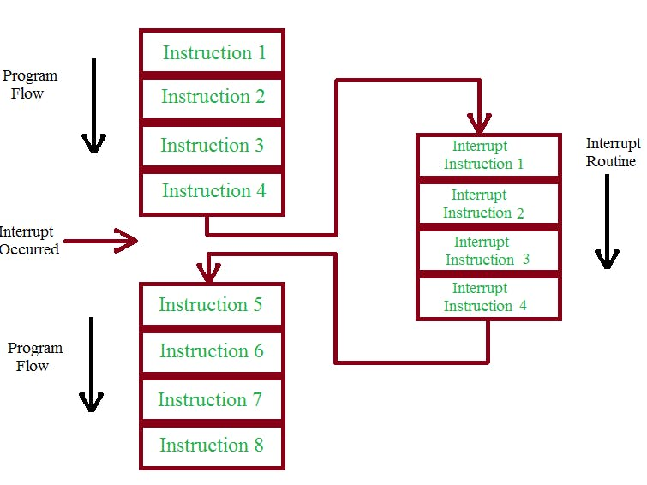


Interrupt Processing Flow
https://www.hackster.io/rafitc/interrupts-basics-f475d5

Slide 43
Question: 學習作業系統為什麼要知道Interrupt的機制與處理方式呢?

Slide 44
Outline
What Operating Systems Do?
Computer-System Organization
Interrupts
Storage structure
Computer-System Architecture
Operating-System Operations

Slide 45
Storage Structure
There are many different storage media
Differ in sizes, speed, cost, volatility (揮發性)…
So, current storage systems are organized in hierarchy.
The top four levels are constructed using semi-conductor memory

Slide 46
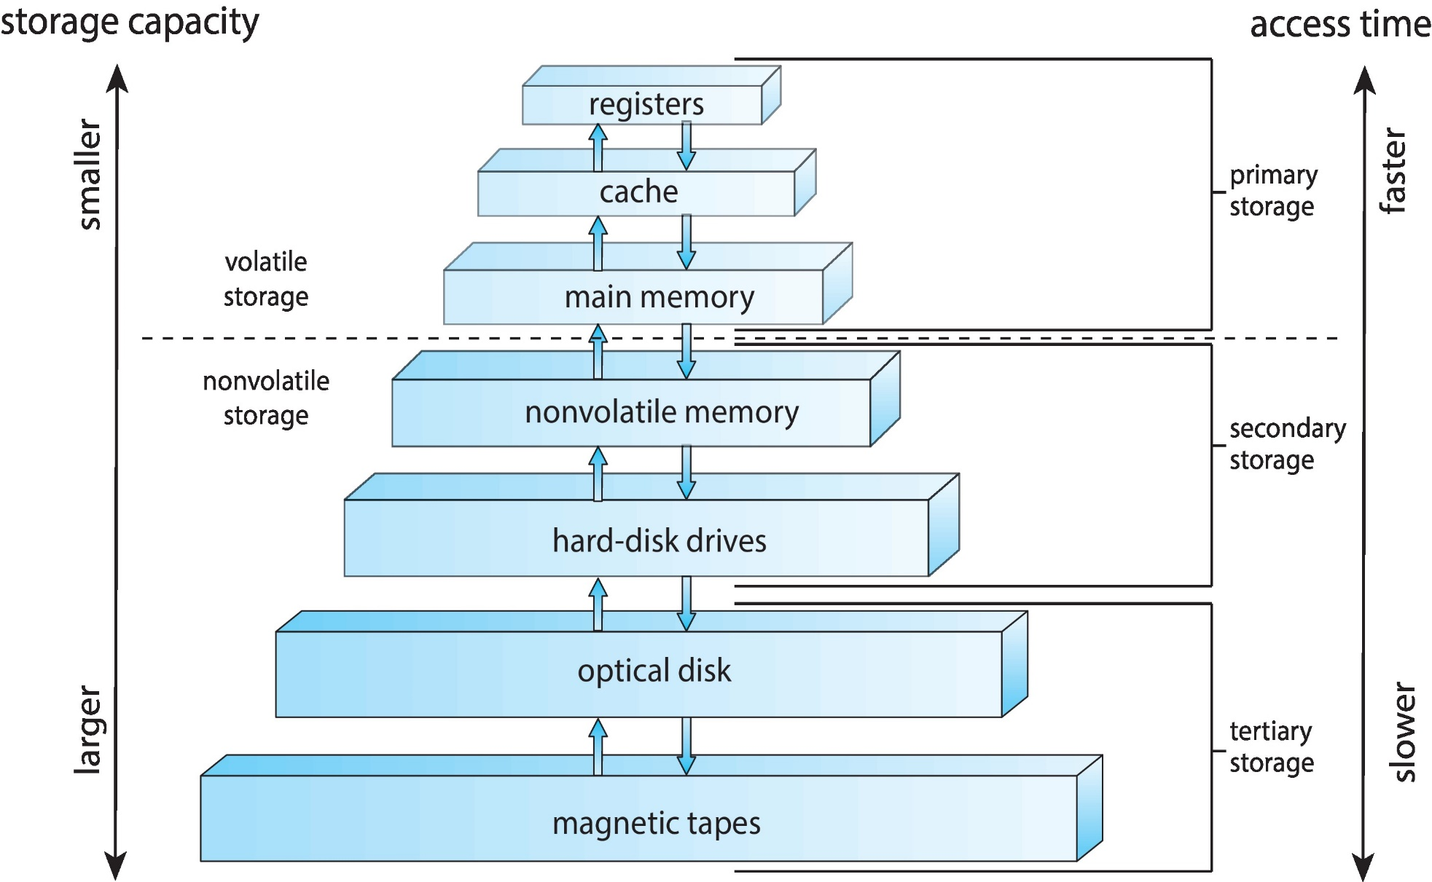
Storage-Device Hierarchy

Slide 47
Performance of Various Levels of Storage

Slide 48
Storage Structure (Cont.)
Primary storage
Main memory: RAM
The only large storage media that the CPU can access directly.
Secondary storage
Mechanical-based: hard-disk drives (HDD) (or called magnetic disks)
Electrical-based: Flash memory (SSD)

Slide 49
Question: 學習作業系統為什麼要知道Storage Structures呢?

Slide 50
接下來介紹計算機架構

Slide 51
Outline
What Operating Systems Do?
Computer-System Organization
Computer-System Architecture
Single-Processor Systems
Multi-Processor Systems
Operating-System Operations

Slide 52
Outline
What Operating Systems Do?
Computer-System Organization
Computer-System Architecture
Single-Processor Systems
Multi-Processor Systems
Operating-System Operations

Slide 53
Single-Processor Systems
Only one general-purpose processor

Slide 54
A Computer System
CPU registers
device registers
Local buffer

Slide 55
Outline
What Operating Systems Do?
Computer-System Organization
Computer-System Architecture
Single-Processor Systems
Multi-Processor Systems
Operating-System Operations

Slide 56
Multi-processor Systems
Advantages: increased throughput
Question: what is throughput?

Slide 57
Multiprocessor Systems
Approaches
Multi-processors: each processor with a single-core CPU
Multi-core systems: multiple cores on a single chip
Non-uniform memory access (NUMA)

Slide 58
Multiprocessor Systems
Approaches
Multi-processors: each processor with a single-core CPU
Multi-core systems: multiple cores on a single chip
Non-uniform memory access (NUMA)

Slide 59
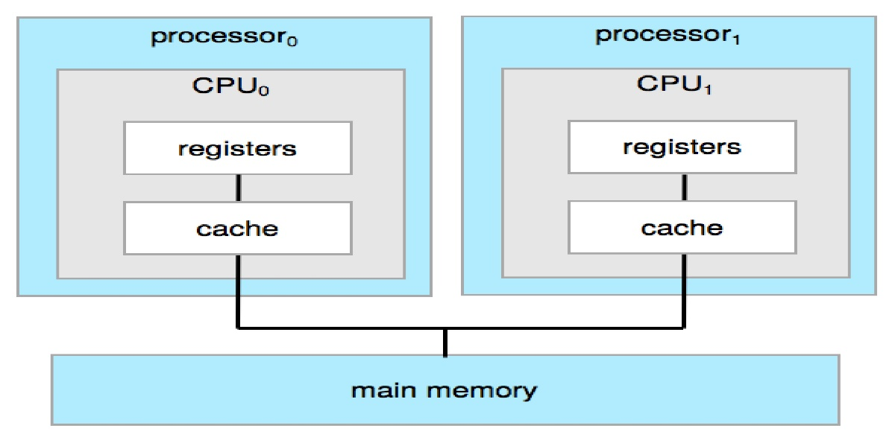
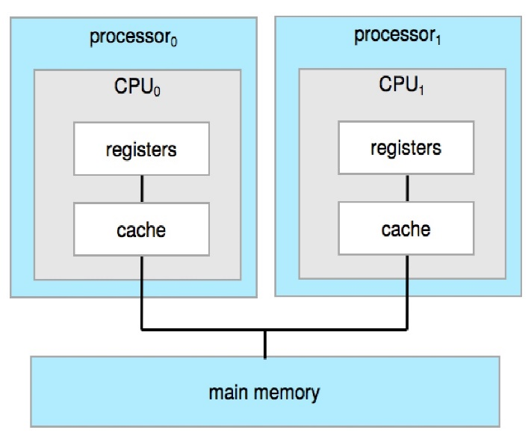
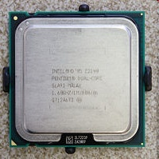
Multiprocessors Systems
main memory

Slide 60
Multiprocessor Systems
Approaches
Multi-processors: each processor with a single-core CPU
Multi-core systems: multiple cores on a single chip
Non-uniform memory access (NUMA)

Slide 61
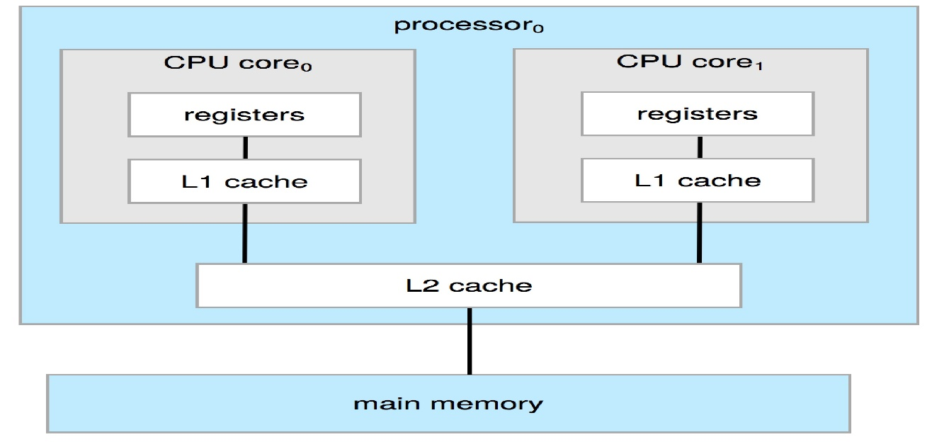
Multi-Core Systems
Multi-Core: multiple compute cores on a single chip
A dual-core design: two cores on the same chip

Slide 62
Multiprocessor Systems
Approaches
Multi-processors: each processor with a single-core CPU
Multi-core systems: multiple cores on a single chip
Non-uniform memory access (NUMA)

Slide 63
理論上, 我們可以透過增加CPU數量 (不管chip是single-core或是multi-cores)的方式來提升效能!

Slide 64
Question: 但實際上, 一直增加CPU數量卻可能沒有看到效能的提升! Why?
Ans: 一個可能的原因是system bus成為效能瓶頸

Slide 65
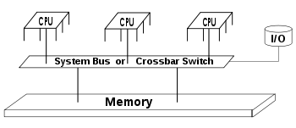
Problems of Adding Too Many CPUs
Problems of adding too many CPUs
Contention for system bus becomes a bottleneck

Slide 66
Question: 怎麼辦呢?
Ans: Non-Uniform Memory Access (NUMA)

Slide 67
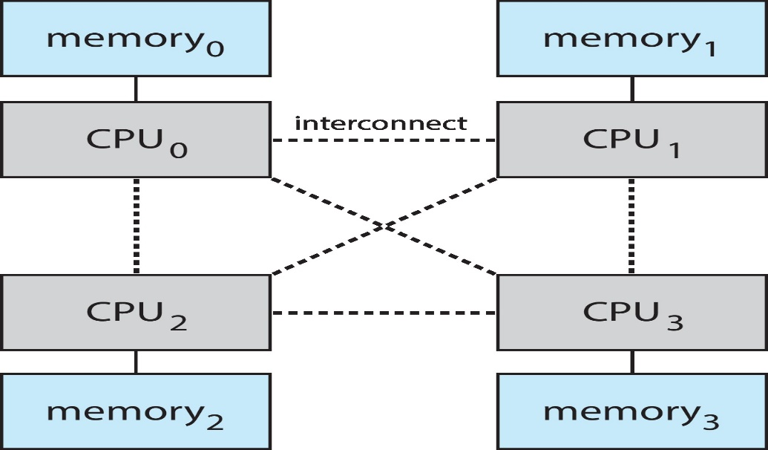
Non-Uniform Memory Access (NUMA)
Alternative approach: NUMA
Provide each CPU with its local memory
Increasing popular on servers and high-end computing systems

Slide 68
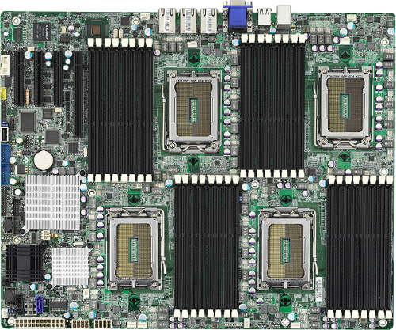
Non-Uniform Memory Access (NUMA) (Cont.)
https://blog.programster.org/kvm-numa-declaration

Slide 69
Question: 可是NUMA會帶來新的問題! 甚麼問題呢?

Slide 70
Non-Uniform Memory Access (NUMA) (Cont.)
Problem: memory access time is not the same
Accessing local memory speed >> accessing remote memory speed
OS need to manage memory carefully.

Slide 71
Question: 學習作業系統為什麼要知道電腦是單核心/多核心或是NUMA呢?

Slide 72
Outline
What Operating Systems Do?
Computer-System Organization
Computer-System Architecture
Operating-System Operations

Slide 73
看過電腦組織與架構，接下來介紹作業系統的基本運作方法

Slide 74
Outline
What Operating Systems Do?
Computer-System Organization
Computer-System Architecture
Operating-System Operations
OS Invocation
Multiprogramming and Multitasking
Timers
Dual-Mode and Multi-mode Operation

Slide 75
基本問題：作業系統何時被執行？
Program 1
Program 2
OS
Device 1
Device 2
Device 3

Slide 76
基本問題：作業系統何時被執行？
…
mov eax, 0x60;
add eax, ebx;
…
CPU
eax | 10
ebx | 5
…..
OS

Slide 77
基本問題：作業系統何時被執行？
當需要OS服務的時候….
誰會需要OS的服務呢?(see the previous slide)
硬體會請求OS的服務: Why and How?
應用程式也會請求OS的服務: Why and How?

Slide 78
Event-Driven OS
作業系統何時被執行?
當硬體和應用程式觸發事件請求OS服務的時候
所以, OS is event-driven
Events
Interrupt: driven by hardware
Trap (or exception): driven by software
Also called software-generated interrupt

Slide 79
Event-Driven OS
OS is event-driven
Events
Interrupt: driven by hardware
Trap (or exception): a software-generated interrupt
Error: Division by zero, illegal instructions
System calls: functions provided by OS to provide service to applications
Ex: read(), write(), open()……

Slide 80
Event-Driven OS: Interrupt
…
mov eax, 0x60;
…
CPU
…..
interrupt
OS
Interrupt Service
Routine (ISR)

Slide 81
Event-Driven OS
OS is event-driven
Events
Interrupt: driven by hardware
Trap (or exception): a software-generated interrupt, caused by
Error: division by zero, illegal instructions
System calls: functions provided by OS to provide service to applications
Ex: read(), write(), open()……

Slide 82
Event-Driven OS: Trap (Error)
…
a = b/0;
…
CPU
…..
trap
OS

Slide 83
Event-Driven OS
OS is event-driven
Events
Interrupt: driven by hardware
Trap (or exception): a software-generated interrupt, caused by
Error: Division by zero, illegal instructions
System calls: functions provided by OS to provide service to applications
Ex: read(), write(), open()……

Slide 84
Event-Driven OS: Trap (System Call)
…
int 0x10; // read()經過compiler處理;
…
CPU
…..
trap
OS

Slide 85
Question：何謂System Calls

Slide 86
Example
#include<stdio.h> #include<sys/types.h> #include<sys/stat.h>
#include<fcntl.h> #include<unistd.h>
#include<stdlib.h> //for exit()
#include <string.h> //for strlen()
int main(){
int fd;
fd = open("myfile.txt", O_CREAT | O_WRONLY, 0600);
if (fd < 0){
printf("Failed to open the fild.\n");exit(1); }
int size;
size = write(fd, "e", strlen("e") );
close(fd);
printf("length of write data=%d \n", strlen("e"));
printf("Number of bytes written on success=%d \n\n", size);
exit(0);
}

Slide 87
按照程式執行的規則，當呼叫open()時，程式應該會跳到對應的open() function。
這個例子：open()就是一個system call
問題：open() function在哪裡？

Slide 88
Program 1
open()…
Program 2
read()…
User Mode
open(), read()
Kernel Mode
open()
{
….
}
read() OS
{
…
}
Storage

Slide 89
System Call介紹結束
第二章會詳細介紹

Slide 90
結論: OS is Event-Driven
Program 1
Program 2
User Mode
system call traps
Error traps
Kernel Mode
OS
interrupts
Device 1
Device 2
Device 3

Slide 91
Outline
What Operating Systems Do?
Computer-System Organization
Computer-System Architecture
Operating-System Operations
OS Invocation
Multiprogramming and Multitasking
Timers
Dual-Mode and Multi-mode Operation

Slide 92
作業系統提供應用程式執行的環境! 第一件事: 作業系統如何管理/執行應用程式呢?

Slide 93
Operating-System Structure
Three different OS structures
Single-programming systems
Multi-programmed systems
Time-sharing (or multitasking) systems

Slide 94
Operating-System Structure
Three different OS structures
Single-programming systems
Multi-programmed systems
Time-sharing (or multitasking) systems

Slide 95
Single-Programming Systems
One application program at a time
After a program is finished, then the next program
一次執行一個應用程式, 結束執行後才會執行下一個
Question: 有什麼缺點呢?

Slide 96
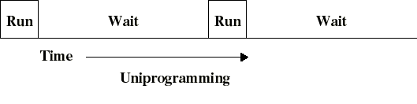
Single-Programming Systems (Cont.)
缺點: very inefficient
CPU is idle when the running program is doing I/O

Slide 97
Operating-System Structure
Three different OS structures
Single-programming systems
Multi-programmed systems
Time-sharing (or multitasking) systems

Slide 98
Multi-Programmed Systems
For efficiency
Run multiple programs keep either the CPU busy at all times
Give an example in your usual life: 小朋友盪鞦韆

Slide 99
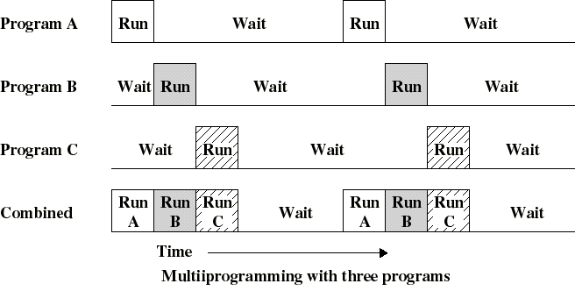
Multi-Programmed Systems (Cont.)

Slide 100
Question: 在multi-programming system中, CPU何時會從應用程式A切換到應用程式B執行?
Ans: 程式結束或是作I/O的時候

Slide 101
Question: 為什麼應用程式做I/O時, 可以執行應用程式的切換呢?
Hint: 這個切換的動作是誰負責處理執行的?

Slide 102
複習: OS is Event-Driven
Program 1
Program 2
User Mode
system call traps
例如: read(), write())
Error traps
Kernel Mode
OS
interrupts
Device 1
Device 2
Device 3

Slide 103
Question: 當應用程式呼叫system call做I/O時才切換應用程式會有甚麼問題呢?
Hint: 如果應用程式很久才做I/O或都不做I/O, 怎麼辦呢?

Slide 104
Problems of Multiprogramming Systems
Problem of multi-programming systems (see the following slide)
不公平的 CPU 使用時間
使用者體驗不佳: cannot provide user interaction

Slide 105
Problems of Multiprogramming Systems
program A
RUN
wait
program B
(word)
wait
RUN
Bad: long response time
interactive task

Slide 106
A Special Case: Program A Executes an Infinite Loop
…
for (;;) a=a+1;
…
Program A executes an
infinite loop
CPU
…
add eax, ebx;
…
…..
Program B has no way for exeuction
OS
Interrupt Service
Routine (ISR)

Slide 107
Question: 怎麼辦呢?
Ans: 強迫切換應用程式的執行

Slide 108
Operating-System Structure
Three different OS structures
Single-programming systems
Multi-programmed systems
Time-sharing (or multitasking) systems

Slide 109
Timesharing (Multitasking)
Solutions: Timesharing (Multitasking) systems
Switching programs actively
Not passively until programs doing I/O
Good
Create an interactive computing environment
Response time is short
CPU usage is fair

Slide 110
Timesharing (Multitasking)
program A
RUN
wait
RUN
program B
(word)
wait
RUN
Good: short response time
interactive task

Slide 111
Outline
What Operating Systems Do?
Computer-System Organization
Computer-System Architecture
Operating-System Operations
OS Invocation
Multiprogramming and Multitasking
Timers
Dual-Mode and Multi-mode Operation

Slide 112
Question: 如何強迫切換應用程式的執行
Hint: 誰負責切換的決策和動作?

Slide 113
Question: 如何進入OS?
如此OS才有機會可以執行切換的動作!

Slide 114
複習: 進入OS的三種方法
Program 1
Program 2
User Mode
system call traps
Error traps
Kernel Mode
OS
interrupts
Device 1
Device 2
Device 3

Slide 115
Question: 你要使用哪一種呢?

Slide 116
How to Implement Time Sharing Systems?
Question: how to implement time sharing systems?
We must have a way to enter OS
System call traps
Error Traps
Interrupts
Your choice?

Slide 117
Solution
We must have a way to enter OS
System call traps
Error Traps
Interrupts

Slide 118
Timer
Solution: timer
A hardware that triggers interrupt periodically
Upon interrupt occurring, CPU jumps to OS
OS check and then select another program to run if necessary
An so on…(see the following two slides)
Clearly, instructions that modify the content of the timer are privileged (introduced later)

Slide 119
With a Timer
User
Applications
…
for (;;)
a=a+1;
…
User
Applications
…
for (;;)
a=a+1;
…
Change to execute another application
User Mode
Kernel Mode
check_and_select()
{
If (current process executes too long)
change to execute another application
}
Interrupt cause
CPU just to the kernel
Hardware
Timer

Slide 120
With a Timer
…
for (;;) a=a+1;
…
CPU
…
add eax, ebx;
…
…..
interrupt
Timer
…
check_and_select(){
}
…
OS
Interrupt Service
Routine (ISR)

Slide 121
事實上, 只要進入OS (例如:timer,網路卡, 硬碟,…等周邊的中斷或是程式呼叫system calls), OS可能就會切換應用程式的執行
第五章會詳細介紹

Slide 122
Question: 既然有網卡,硬碟等周邊會觸發中斷, 那為什麼還需要timer?

Slide 123
Outline
What Operating Systems Do?
Computer-System Organization
Computer-System Architecture
Operating-System Operations
OS Invocation
Multiprogramming and Multitasking
Timers
Dual-Mode and Multi-mode Operation

Slide 124
Question:某些CPU instructions(例如:cli)可能很危險,我們不想讓應用程式執行! 如何辦到呢?
Possible Solution:
規定應用程式不可以使用這些instructions?

Slide 125
目標:某些CPU instructions只可以讓OS執行, 不可以讓應用程式執行!
Question: 如何辦到呢?
Hint: 必須仰賴CPU還是OS呢? (see the next slide)

Slide 126
CPU Fetches Instructions for Executions
…
add eax, eax, 10;
jmp target
…
CPU
…
add eax, ebx, 5;
…
…..
OS

Slide 127
目標: 所以CPU必須區隔目前是作業系統在執行還是應用程式在執行
只有當作業系統執行時, 才可以執行上述某些危險的instructions

Slide 128
Privileged Instructions
Privileged instructions
上述危險的instructions
Instructions that may cause harm
Example:
I/O control, timer management, interrupt management

Slide 129
複習: Timer
Solution: timer
A hardware that triggers interrupt periodically
Upon interrupt occurring, CPU jumps to OS
OS then select another program to run (maybe still the same program)
An so on…(see the following two slides)
Clearly, instructions that modify the content of the timer are privileged.

Slide 130
Question: Why instructions modifying the timer are privileged?

Slide 131
Dual-Mode Operations
如前述, CPU must distinguish between the execution of OS code and user program code
Why? (see the following slide)
Solution: CPU supports dual-mode operations

Slide 132
Distinguish between Executions Of OS and User Program
…
cli; //clear interrupts
…
CPU
…..
V
…
cli;
…
OS

Slide 133
Dual-Mode Operation
Modern CPUs have at least two execution modes:
User mode – execution done on behalf of user programs
Cannot execution privileged instructions
Monitor mode– execution done on behalf of OS
Also called supervisor mode, system mode, or privileged mode
Can executed all of the instructions, including privileged instructions

Slide 134
Q: CPU如何區分這兩種模式? 也就是CPU如何知道目前是處於哪一種模式 ?
Ans: a mode bit.

Slide 135
複習: 1.3.1 SIC Machine Architecture (Cont.)
Registers
Five registers
Each register is 24 bits in length
Mnemonic | Number | Special use
A | 0 | Accumulator
X | 1 | Index register
L | 2 | Linkage register
PC | 8 | Program counter
SW | 9 | Status word

Slide 136
複習: 1.3.1 SIC Machine Architecture (Cont.)
Status Word register contents

Slide 137
Dual-Mode Operation (Cont.)
Privileged instruction can only execute in kernel mode
問題:如果應用程式硬要執行privileged instructions呢?
If executed in user mode, hardware will cause a trap
Trap cause CPU jump to OS, that terminates the application
See the next slide

Slide 138
Dual-Mode Operation
…
cli;
…
CPU
…..
mode = 0;
trap
OS

Slide 139
Question: CPU何時會切換mode bit?
Hint: CPU何時會從應用程式進入到OS執行?又何時會回到應用程式執行?

Slide 140
Dual-Mode Operation (Cont.)
Entering Monitor Mode (the same as entering OS)
Interrupt
System call trap
Error trap

Slide 141
Mode Bit Change: Interrupt
…
out eax, 0x60;
…
CPU
…..
mode = 1;
mode = 0;
interrupt
OS
Interrupt Service
Routine (ISR)
…
iret

Slide 142
Mode Bit Change : Trap (Error)
…
a = b/0;
…
CPU
…
x = x + 1;
…
…..
mode = 0;
mode = 1;
trap
OS
iret

Slide 143
Mode Bit Change : Trap (Error)
…
cli;
…
CPU
…
x = x + 1;
…
…..
mode = 0;
mode = 1;
trap
OS
iret

Slide 144
Mode Bit Change: Trap (System Call)
…
int 0x 10; // read();
…
CPU
…..
mode = 1;
mode = 0;
OS
read()
{
iret;
}

Slide 145
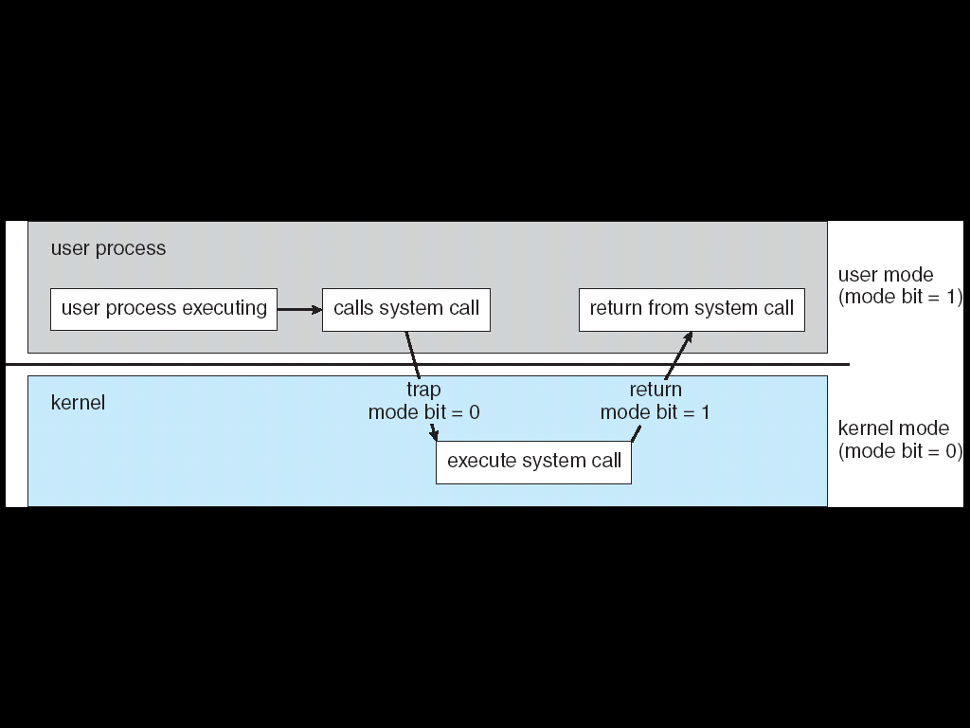
Dual-Mode Operation: 以System Call Trap為例子
0
1
0
1

Slide 146
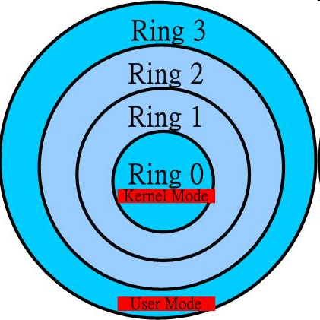
Multi-Mode
Examples
x86 CPU has four protection rings (modes)
Windows runs in the ring 0 (kernel mode)
User applications runs in the ring 3 (User mode)
ARM8 has seven modes

Slide 147
結論：作業系統的基本運作方法和CPU/硬體有密切關係
Timer
Dual-Mode Operation

Slide 148
Summary
Computer System Structure
Hardware, operating system, system and application programs, users
Computer-System Organization
Interrupts
Storage structure
Computer-System Architecture
Single-Processor Systems
Multiprocessor Systems
Operating-System Operations
OS Invocations
Multiprogramming and Multitasking
Timers
Dual-Mode and Multi-mode Operation

